Slide 1
Mobilenet v2 introduction
Hongshuo Wang

Slide 2
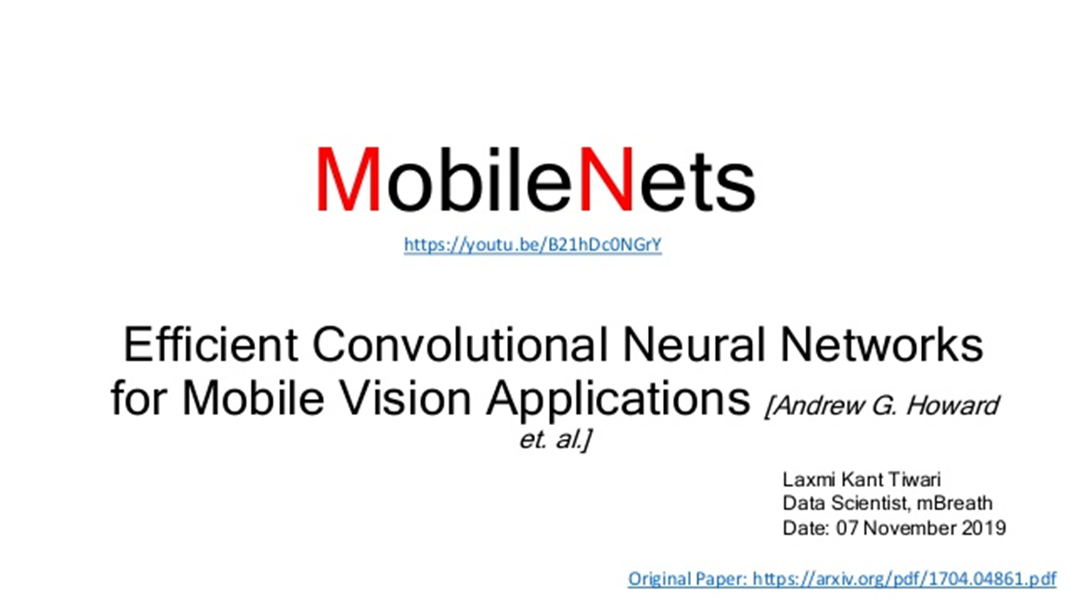
Depthwise Separable convolution
Structure
Relu6
Inverted Residuals
Linear Bottlenecks
Transfer Learning
Visualization
Demo

Slide 3

Depthwise Separable Convolution
Depthwise Convolution
Pointwise Convolution

Slide 4
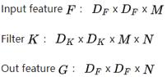
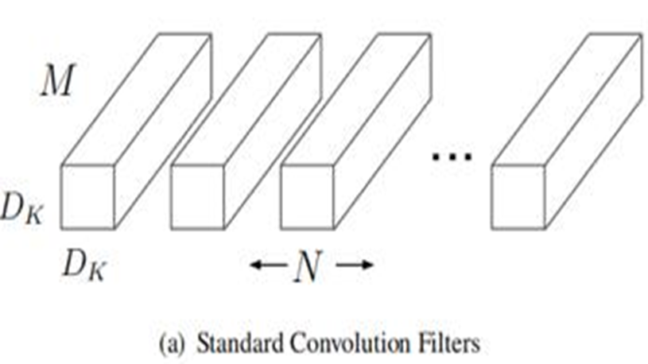
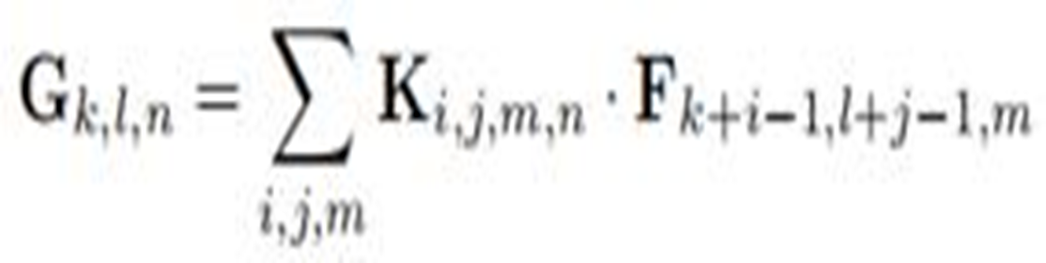
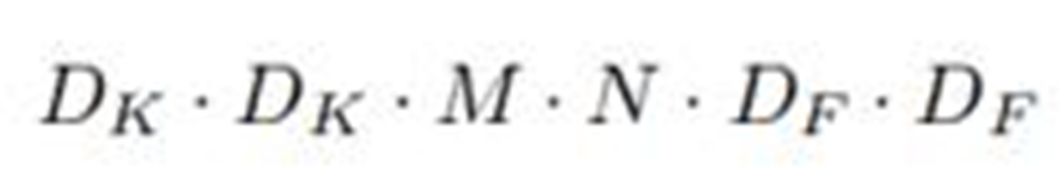
Standard Convolution Size

Slide 5

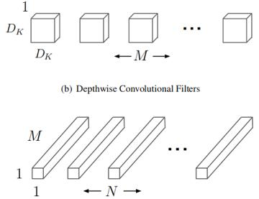


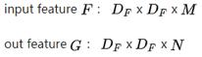
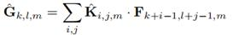

Depthwise separable convolution

Slide 6
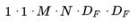
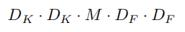
Depthwise parameters
Pointwise parameters
Total

Slide 7
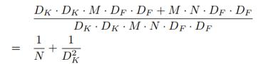
comparison with standard

Slide 8
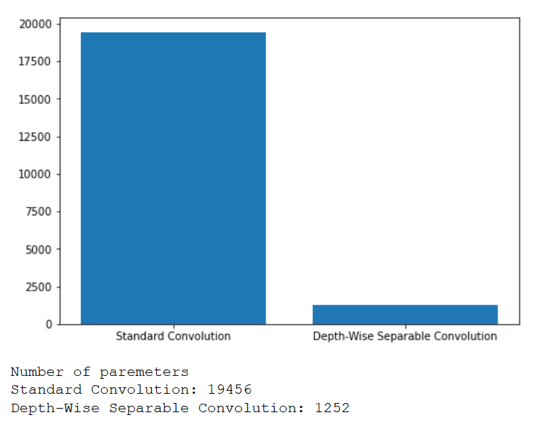
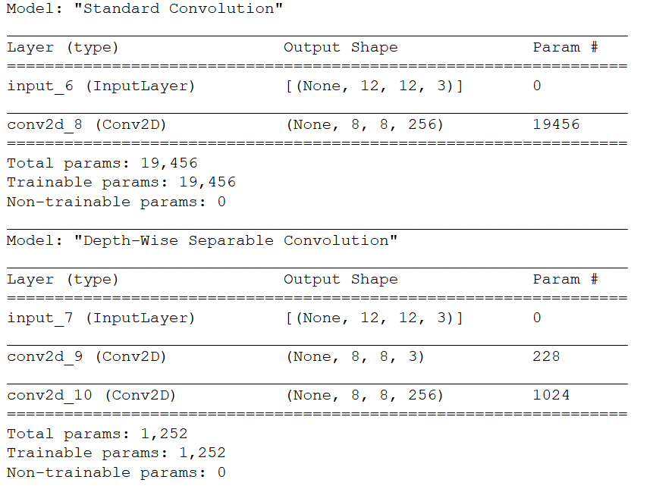

Slide 9
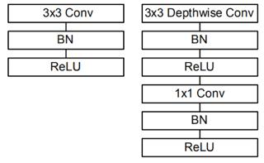
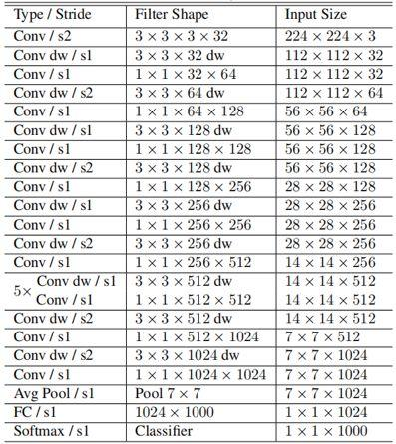
Mobilenet Structure

Slide 10
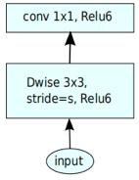
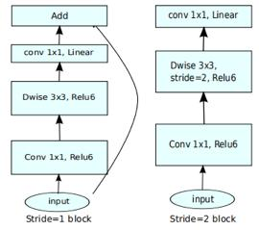
Mobilenet and Moilenet v2

Slide 11
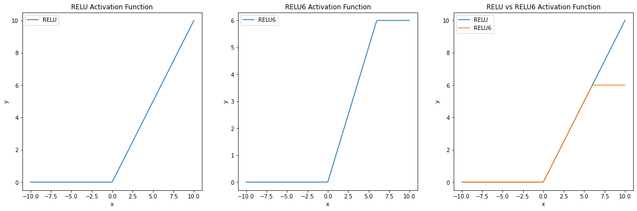
Relu6

Slide 12
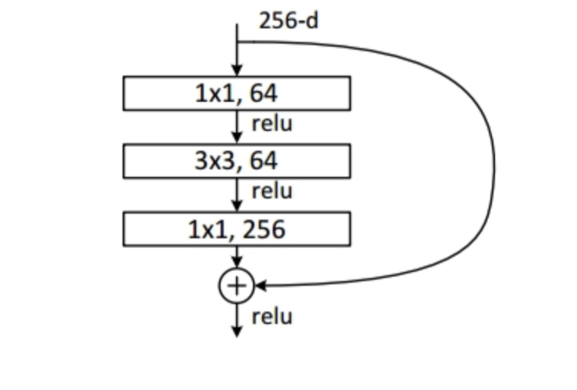
Inverted Residuals
ResNet
Skip Connection
Wide(256) -> narrow(64) -> wide(56)

Slide 13
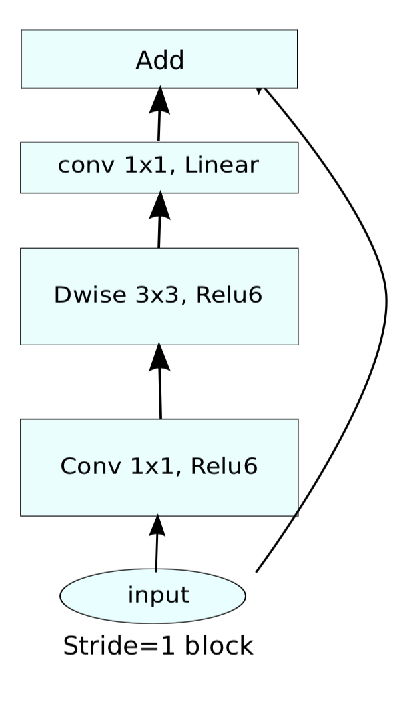
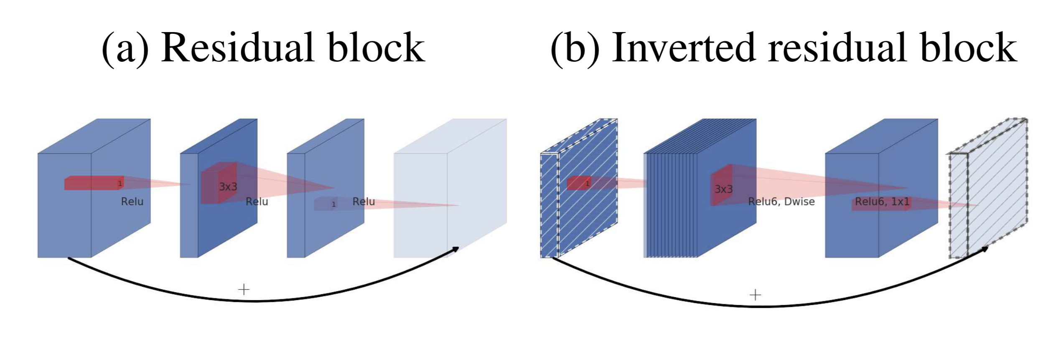
Inverted Residuals
MobilenetV2
Depthwise Separable Convolution
Narrow -> Wide -> Narrow
Skip Connection between Bottleneck

Slide 14
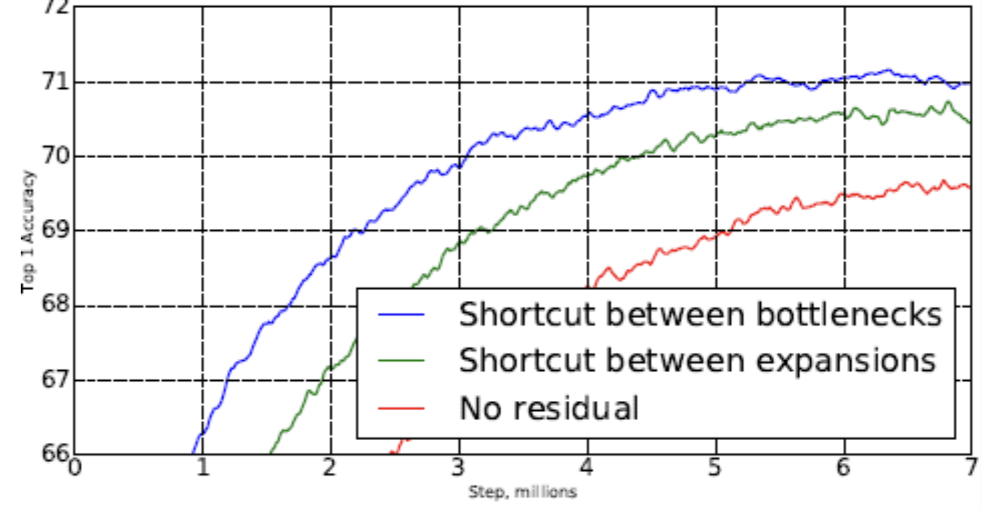
Inverted Residuals
Compare to ResNet:
Fewer Parameters thanks to Depthwise Separable Convolution
Higher Accuracy

Slide 15
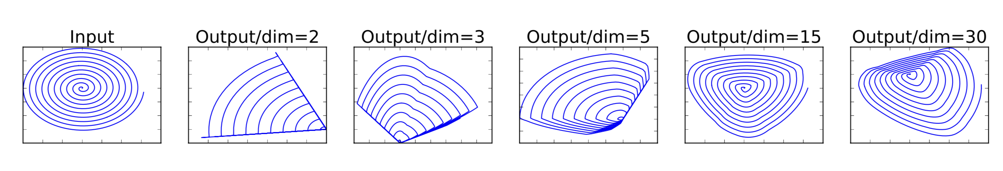
Linear Bottleneck
Recall non-linear Activation Function & RELU
Pros: introducing non-linearity into the network
Cons: Serious information loss in low dimension

Slide 16
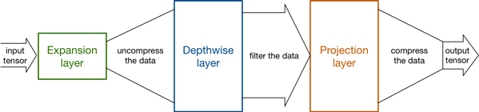
Linear Bottleneck
Solution in Mobilenet V2: Linear Bottleneck
Due to the narrow -> wide -> narrow structure, it's okay to use RELU after depthwise layer
However, the last convolution of a residual block has a linear output

Slide 17
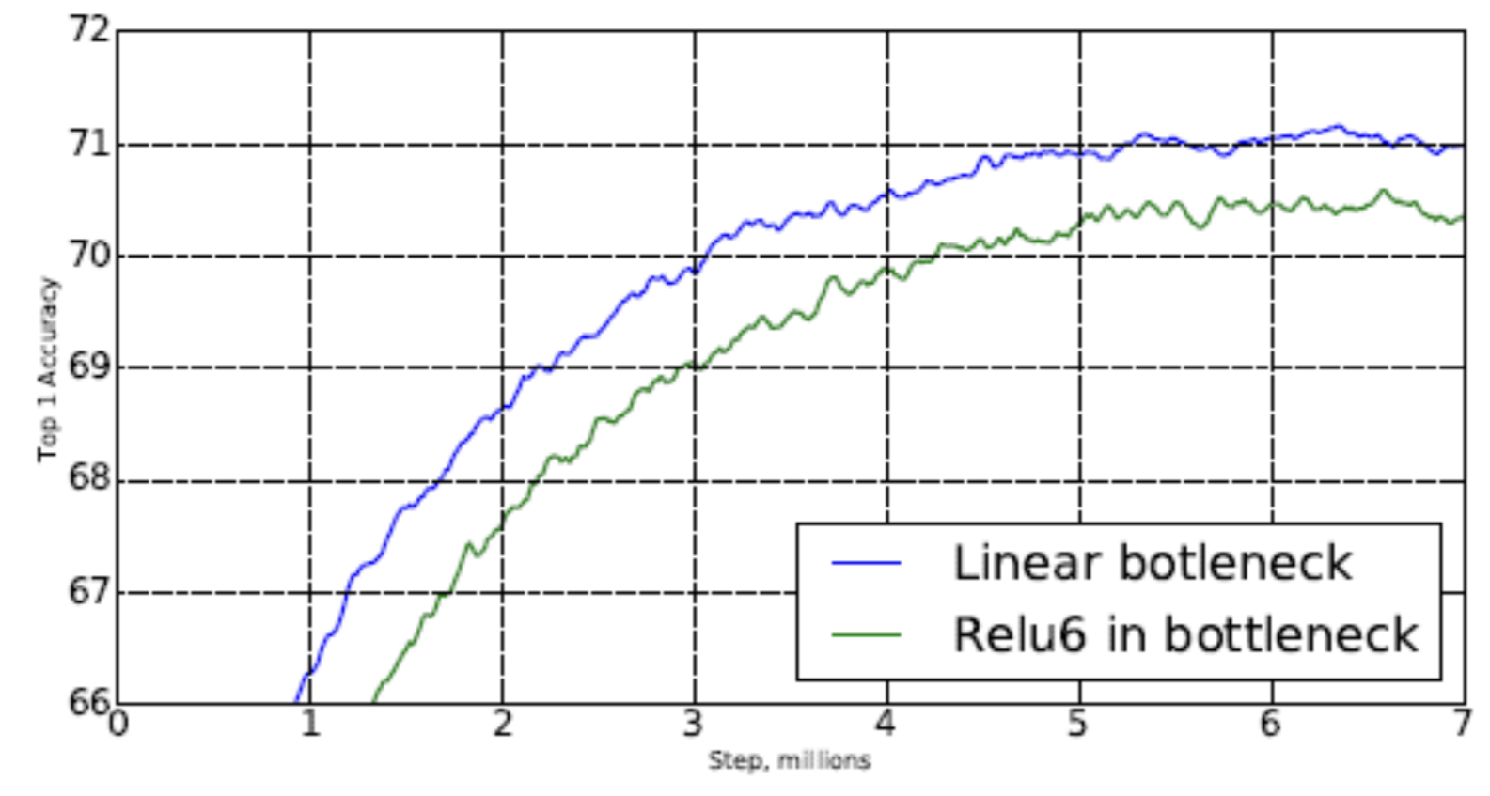
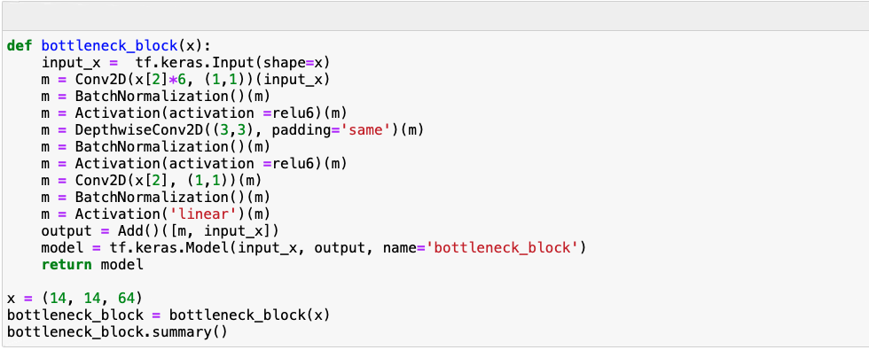
Linear Bottleneck

Slide 18
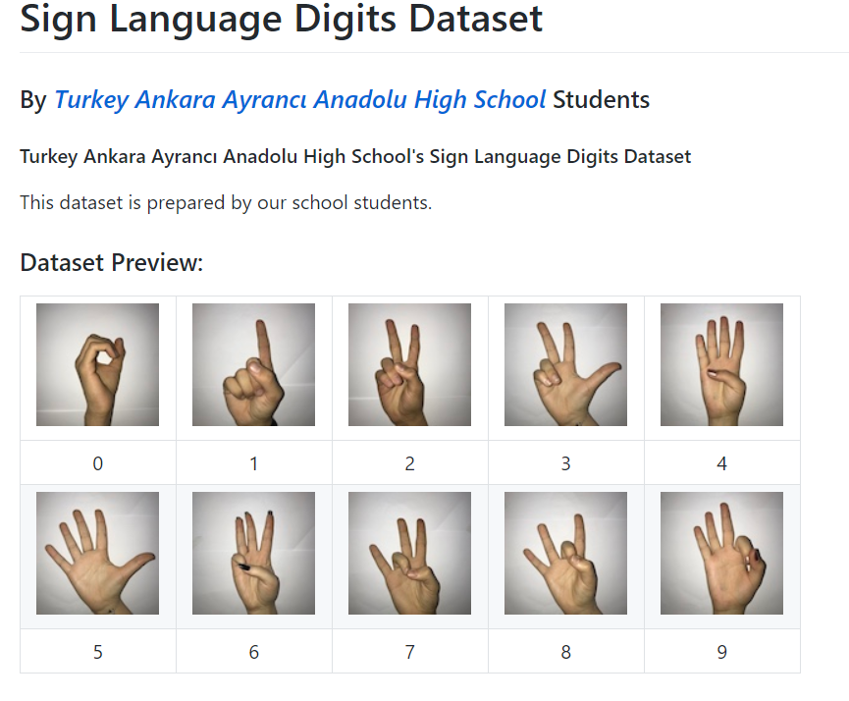
Transfer Learning
Training datasets: the sign language gestures for the digits 0-9
Modified last layers from 1000 class to 10 (10 signs in total)
Freeze the first half of trained model and only train the last half (# train 10-16th bottle blocks
Notes:
After introducing the architecture of Mobilenetv2, we implement an demo to demonstrate our model by using transfer learning on sign language digits datasets. Besides modifying the output layers from 1000 classes to 10 classes, we also freeze the first half of model, and only train from 10th -16th bottle blocks since the pretrained model has already learnt lots of edges and corners details in the first half of weights. All we need to do is training the last half of model to classify images. It took 20 minus to train on GPU in order to get our desired results. You can see further details in our notebook.

Slide 19
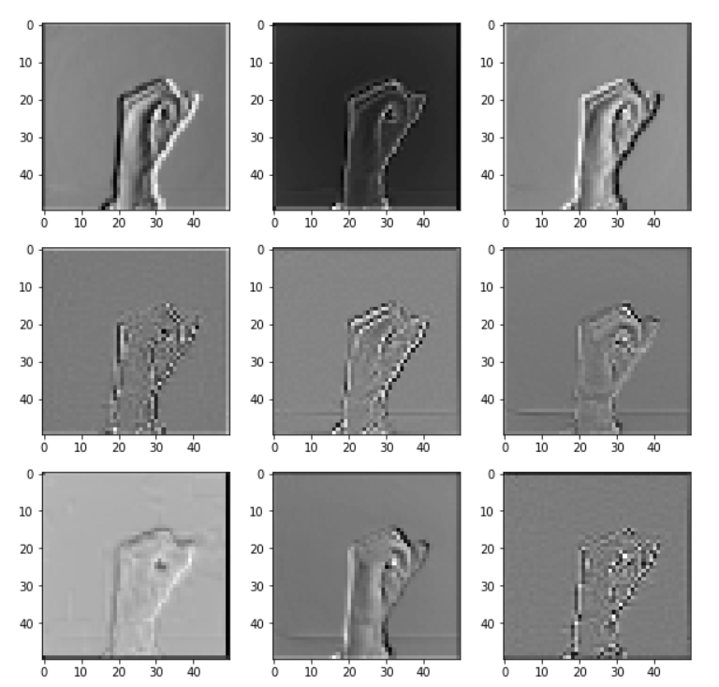
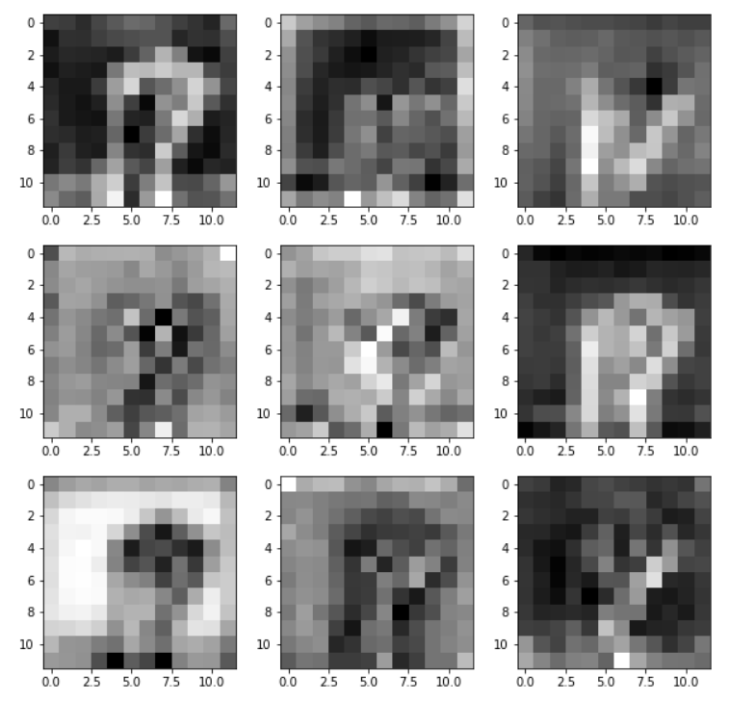
Visualization
9 feature maps :
Visualizing the Depthwise Process Visualizing the 5th Bottle Block

Slide 20
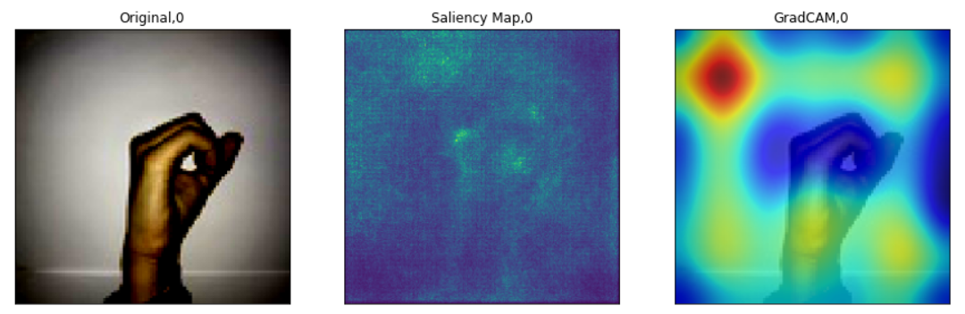
Visualization
Saliency Maps: recognize and segment the gestures to show the pixels in the image most pertinent to classification
Grad-CAM: use color or brightness to express the weight of features to explain the basis of classification

Slide 21
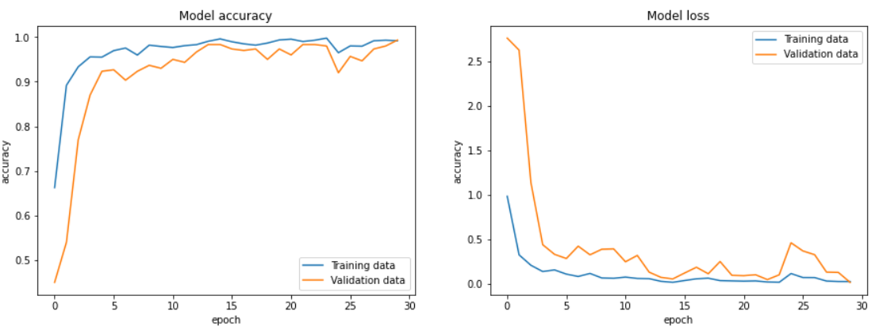
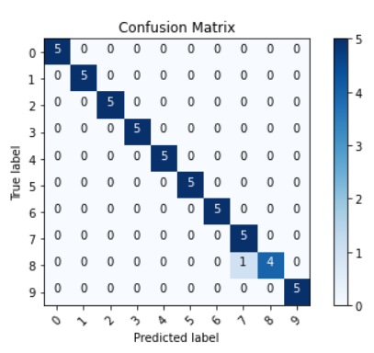
Visualization
Confusion Matrix
Training/Validation Accuracy/Loss
Visualizing the Testing Process

Slide 22
Reference
https://towardsdatascience.com/review-mobilenetv2-light-weight-model-image-classification-8febb490e61c
https://towardsdatascience.com/mobilenetv2-inverted-residuals-and-linear-bottlenecks-8a4362f4ffd5
https://hackernoon.com/tf-serving-keras-mobilenetv2-632b8d92983c
https://arxiv.org/abs/1801.04381
https://towardsdatascience.com/understanding-and-calculating-the-number-of-parameters-in-convolution-neural-networks-cnns-fc88790d530d

